Slide 1
Tarefa Planner Web version

Slide 2
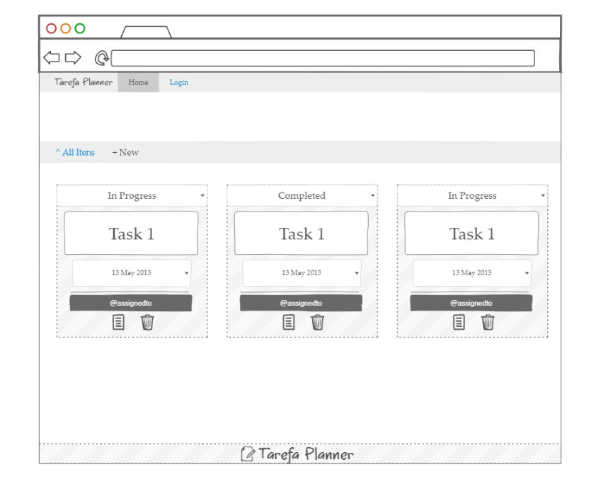
Home Page

Slide 3
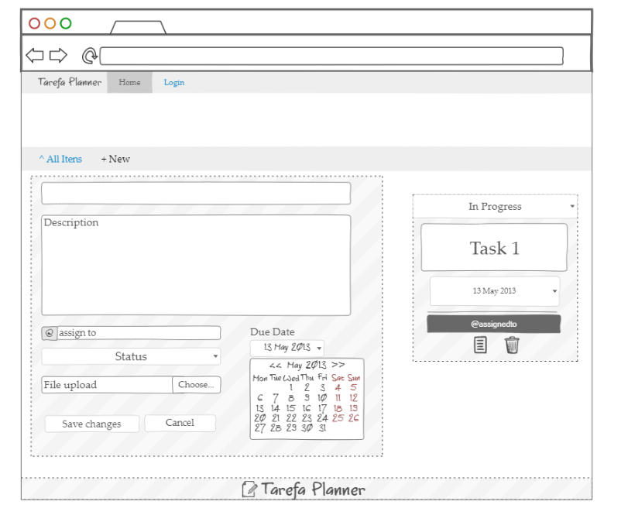
New Task

Slide 4
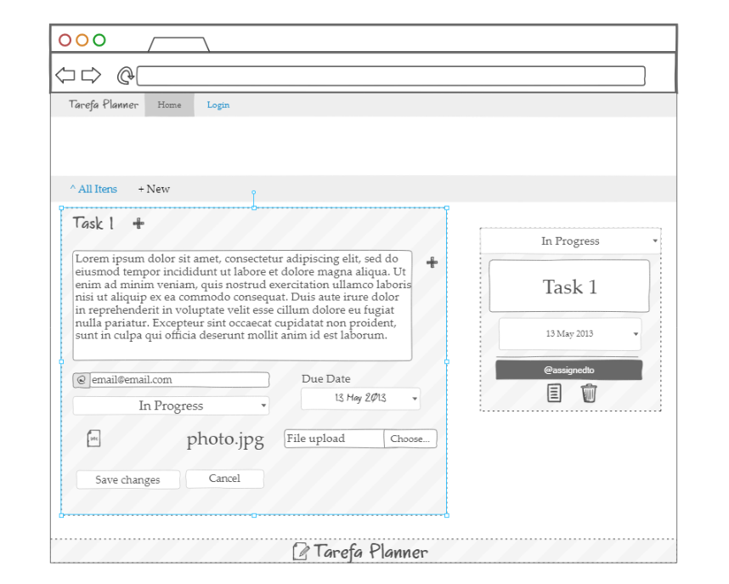
Open Task

Slide 5
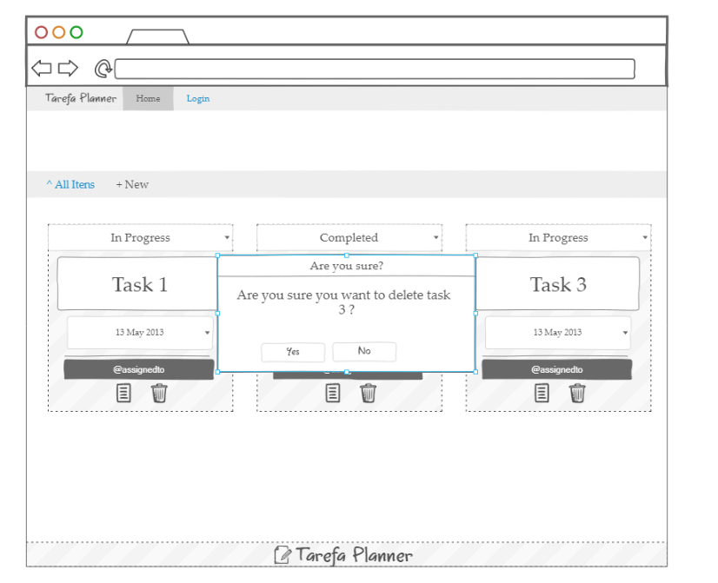
Delete Task

Slide 6
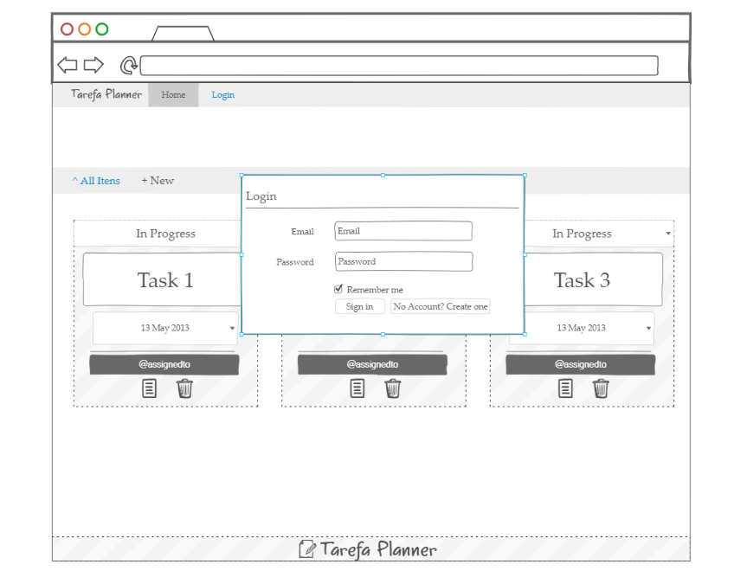
Login Page

Slide 7
Tarefa Planner Mobile version

Slide 8
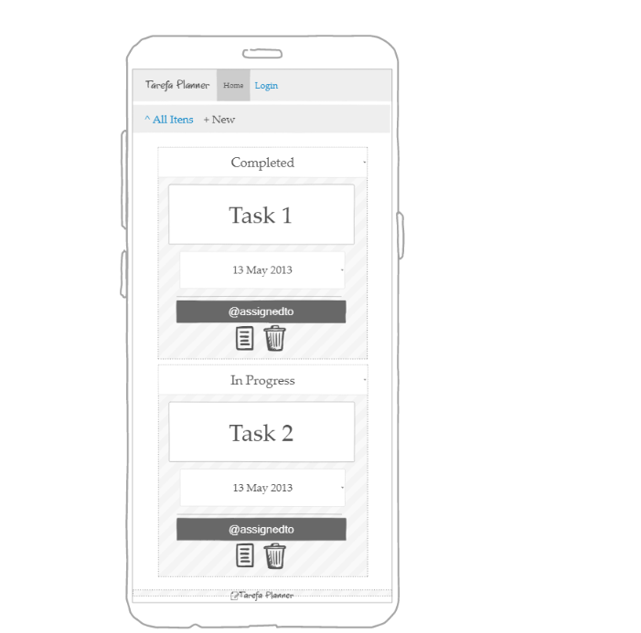
Mobile Home Page

